Slide 1
Ethernet Cabling Techniques

Slide 2
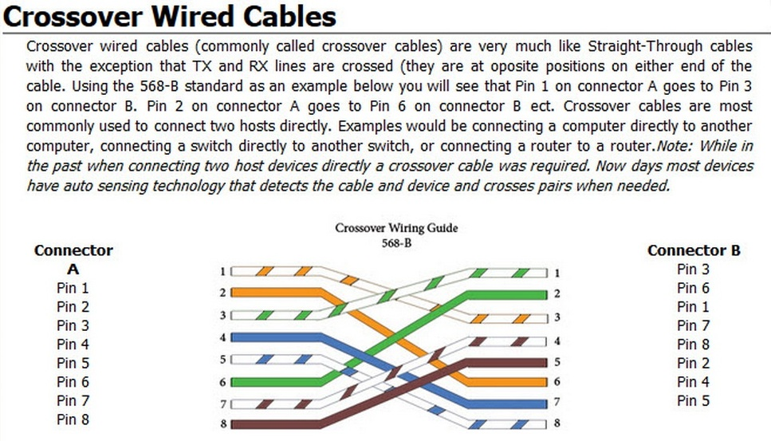

Slide 3
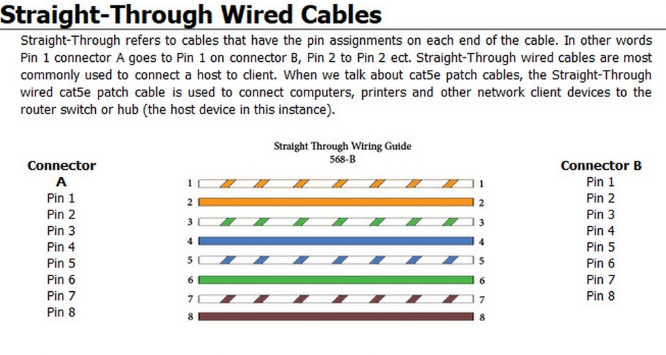

Slide 4
